Slide 1
Multi-label Text Classification using BERT with RLHF Integration
Case study Machine Learning Engineer

Slide 2
Problem Statement
Objective: 1. Perform Multi-label classification using BERT model. 2. Classify research papers into multiple categories based on their title and abstract.
Challenges:
Handling multi-label output.
Leveraging feedback (Reinforcement Learning with Human Feedback - RLHF).

Slide 3
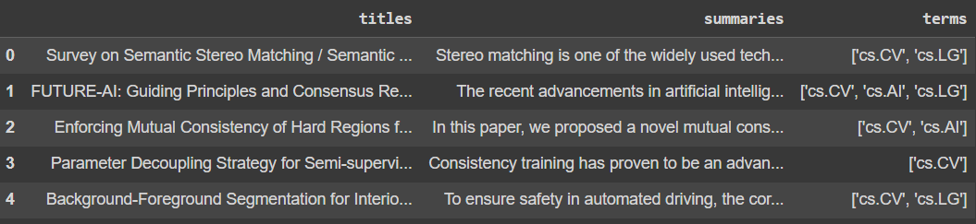
Dataset Overview
Dataset: Research papers from [Source, e.g., ArXiv].
Columns:
title: The title of the paper summary: Abstract of the paper terms: Multi-label categories.
Preprocessing:
Combine title and summary to form input text.
Use MultiLabelBinarizer for one-hot encoding of labels (terms).

Slide 4
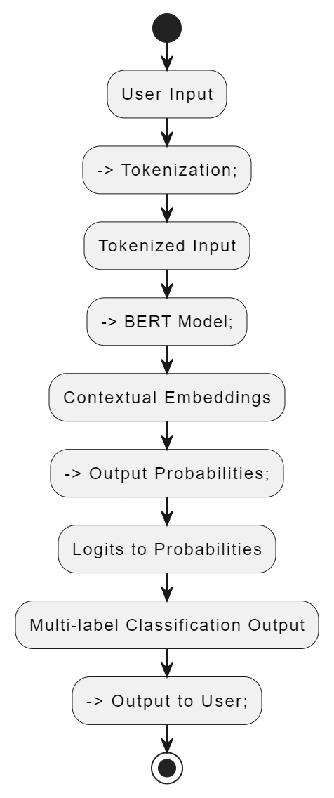
Model Architecture
User Input: Title and summary
Base Model: BERT (Pretrained Transformer Model).
Tokenizer: BertTokenizer
Output: categories or terms

Slide 5
Training Process
Dataset Splits:
Training (60%) Validation (20%) Test (20%)
Tokenization: Convert text into tokens (BERT tokenizer).
Loss Function: BCEWithLogitsLoss (Binary Cross-Entropy for multi-label classification).
Early Stopping: Monitors validation loss for stopping if no improvement is seen. Training is done with a small number of epochs(5) and early stopping to avoid overfitting.

Slide 6
Model Evaluation
RLHF Integration
Accuracy: 0.41062288749396425
Precision: 0.8701328447091159
Recall: 0.5439056981960485
F1-Score: 0.6693879948314342
Current Attempt: I began integrating RLHF using the trl library and designed a reward trainer to improve the model using feedback.
Closing Note: Although I couldn’t complete this part, given more time, I would have invested in learning RLHF more deeply and implementing it to further enhance the system.

Slide 7
Deployment and Model Access
Hugging Face Hub: The trained model and tokenizer are available on Hugging Face for easy access.
Deployment Steps:
Model saved locally and pushed to the Hugging Face repository.
MultiLabelBinarizer object saved for label transformation.
Link: https://huggingface.co/Suyash07/MLC_BERT/tree/main

Slide 8
Conclusion
Key Takeaways:
Successfully built a multi-label classification system using BERT.
Model evaluation shows promising results.

